Slide 1
Bayesian data analysis: Part 3
Alan Pickering
Dept. of Psychology
Goldsmiths, University of London
a.pickering@gold.ac.uk

Slide 2
Preliminaries
All the materials for this set of workshops/tutorials are in an open access repository
https://github.com/Alan-Pickering/Bayesian-data-analysis-teaching
You should review the slides for parts 1 and 2
Bayesian Data Analysis Part 1.pptx
Bayesian Data Analysis Part 2.pptx
before going through this set of slides (part 3) for the first time.

Slide 3
Overview
An introduction to Bayesian Inference and Estimation
Including a look at the arguments in Bayes and Price’s (1764) original article

Slide 4
Uses of Bayes’ Theorem: Part 3
Bayes theorem as a theorem of inverse probability
Estimating parameters using Bayesian methods
How these relate to, and contrast with, the methods of classical statistics (maximum likelihood estimation in particular)

Slide 5
Bayes Theorem
It is often described as a theorem about inverse probability
We know about forward probabilities: if it is a fair deck of cards (F) what is the probability that a card, drawn at random, will be a spade (S)?
Answer= 1/4
P(S|F)= probability of a spade GIVEN* a fair deck =1/4
*given also referred to as being CONDITIONED UPON

Slide 6
Inverse probability
If we draw a spade at random (S) what is the probability that it is a fair deck (F)?
What is p(F|S)?
In principle, we can use Bayesian inference, based on Bayes’ theorem, to work it out

Slide 7
Applying Bayes’ theorem to the card problem 1
We know p(S|F)=1/4
From Bayes’ theorem
p(F|S) = p(S|F)*p(F)/p(S)
To do so we thus need an estimate of the prior probability of a “fair deck”, p(F). What should that be?
Before Bayes and Price’s paper, statisticians weren’t convinced that prior probabilities were meaningful in many situations, nor had anyone proposed a way they might be readily estimated

Slide 8
Applying Bayes’ theorem to the card problem 2
We can make the example more constrained and so allow simple Bayesian inference
Suppose I have 2 decks: one fair (F), one not fair (~F; with half the cards being spades)
I choose one of these decks at random, so p(F)=0.5 (we have radically simplified the “prior”)
Now I pick a single card at random from the deck and it is a spade, S. What is p(F|S) in this example?

Slide 9
Applying Bayes’ theorem to the card problem 3
We know p(S|F) = 0.25 and p(F) = 0.5
and p(S|~F) = 0.5 and p(~F) = 0.5
Bayes theorem (BT) states
p(F|S) = p(S|F) * p(F) / p(S)
and law of total probability says
p(S) = p(S|F) * p(F) + p(S|~F) * p(~F) = 0.375
So using BT and the values above we get p(F|S) = 1/3
Meaning that the prob. of a fair deck has decreased from ½ (before) to 1/3 (after) selecting a single spade!

Slide 10
How did Bayes approach the inverse problem and the issues of priors?
We can consult the original paper he wrote on the topic, although it is hard to read given it uses the mathematical techniques and arguments of its day which are very unfamiliar to the modern reader.

Slide 11
The original paper
Bayes, T., & Price, R. (1764). An essay towards solving a problem in the doctrine of chances. Philosophical Transactions of the Royal Society of London, 53, 370–418.
Published in 1764, after Bayes’ death in 1761, by his friend Richard Price, another church minister who was literary executor of his estate. Price edited out some sections and made several comments and additions to the text.

Slide 12
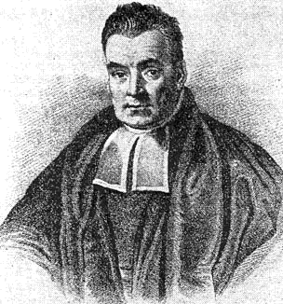
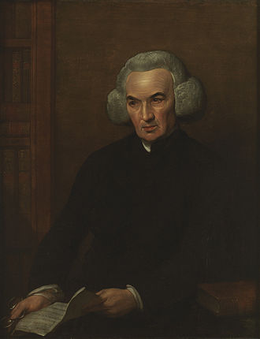
Bayes and Price

Slide 13
Bayes and Price (1764; B&P)
The genius of this paper was to work out a (slightly) more general approach:-
i) by using whole prior probability distributions, with associated parameter(s)
ii) the example they used involved balls on a billiard table (see next rest of slides below)
iii) B&P also worked out some approximate methods for computing the probabilities concerned by hand
i) to iii) enabled B&P, for a series of examples, to compute a range of posterior probabilities after an event, given the prior probabilities and parameter values

Slide 14
The Billiard Table Example 1
A short (<5 min) video by Bayesian statistician David Spiegelhalter (DS; interviewed by Brian Cox)
DS also sets up Bayes’s classic billiard ball problem discussed in B&P (1764)
Watch the video here
https://youtu.be/-e8wOcaascM

Slide 15
The Billiard Table Example 2
Trying to estimate the position of a target ball (now removed) along the long axis of the table
Estimate this by throwing sample of n balls (here 5) that rest randomly on the table; & reporting number (p; =2) to left of target
Position of target ball
2 balls end up to the left of the target ball
0
1

Slide 16
The Billiard Table Example 3
a) The neat feature of this example is that the prior prob. distribution of the position parameter (θ) is uniform and random (the target ball could be anywhere along the table with equal probability)
b) Bayes wanted to estimate the probability that the position of the target ball (θ) lay between certain values, given that one observed X = p balls lying to left of the target ball
c) From a) above Bayes knew that the distribution of X was binomial, allowing probabilities to be estimated.

Slide 17
The Billiard Table Example 4
The best discussion of Bayes’ use of the billiard table example, that I know of, is this one:-
Stigler, S. M. (1982). Thomas Bayes’s Bayesian inference. Journal of the Royal Statistical Society. Series A , 145(2), 250–258.
Stigler claims that Bayes was reluctant to assume, as a general principle, that the distribution of θ (the position of the target ball) was uniform simply because he didn’t know where the target ball was
Stigler also claims that Bayes believed all readers would not accept this justification for the assumption of uniform θ (NB setting priors has always been a thorny issue for Bayesians!)

Slide 18
The Billiard Table Example 5
Assuming θ followed a uniform random distribution, Bayes instead proved the probability that there would be X=p balls to the left of the target, in a sample of n balls, was uniform for all values of p
Specifically, he showed that this constant probability was equal to 1/(n+1)
In modern notation:-

Slide 19
The Billiard Table Example 6
To see why this is so, for n=5, and squashing the billiard table into a single dimension and denoting the balls to the left of the target ball position in white
If we know nothing about where the target ball is, then the following n+1 = 6 outcomes for X=p are all equally likely
p=0
p=1
p=2
…
p=5

Slide 20
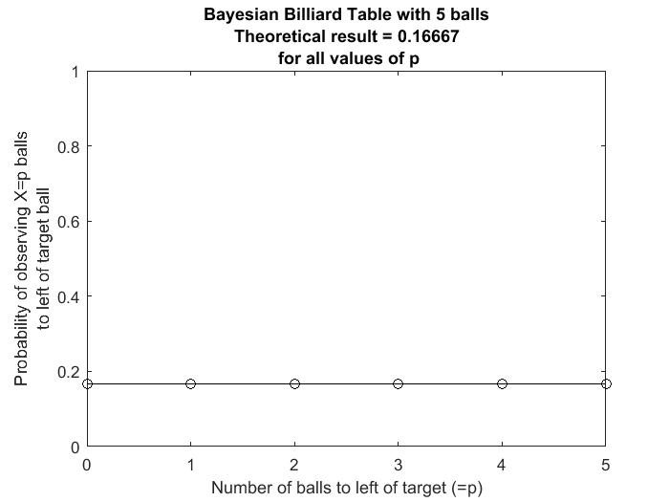
The Billiard Table Example 7
Check with my Matlab script,
constantX_check.m
which computes the integral
For 0<=p<=n
and you can vary, n, the number of balls used
Sample output from my script

Slide 21
The Billiard Table Example 8
Bayes preferred to use a prior distribution of an observable event (X; =number of balls to the left of the target) rather than something unobservable (θ)
He felt that his billiard table analogy could be applied to a range of other problems where θ was unknown
In Bayes’ own words, the analogy applies:-
If “we absolutely know nothing antecedently to any trials made concerning” a probability such as θ, and we have “no reason to think that, in a certain number of trials, [an event] should rather happen any one possible number of times than another”

Slide 22
The Billiard Table Example 9
The final part of Bayes’ argument has 3 steps:-
1) The fact that P(X=p) is a constant for the billiard table was based on the safe assumption, in this case, of uniform θ
2) In any analogous situation where “absolutely know nothing”, we can likewise assume that P(X=p) is constant for all p
3) If P(X=p) is constant for all p in the analogous situation then this implies θ is uniform for that situation too (Bayes did not prove this assertion, which is actually not true in all cases)
NB Bayes’ arguments apply only to binomial distributions, but it has been extended to other cases subsequently.

Slide 23
The Billiard Table Example 10
In the Spiegelhalter video clip, using this example, DS argues (without giving details) that the Bayesian “point estimate” for θ is 3/7. See later slides for why it is 3/7.
This contrasts with the value using later classical statistical estimation (eg by Fisher).
The classical approach would be to use the maximum likelihood estimate (MLE) of the position of the target ball
Based on the fact that 2 out of 5 balls fell to the left of the target ball, the MLE = 0.4

Slide 24
How is the Bayesian point estimate arrived at?
This can be seen in my Matlab script
bayes_table.m
which allows iterative estimation of the position of the target ball over multiple trials with sets of balls. It can be run with a single trial and the settings that apply to the Spigelhalter video case.
This Matlab programme uses numerical integration. The following slides (to be added) show how the answer is derived more quickly and directly.

